Slide 1
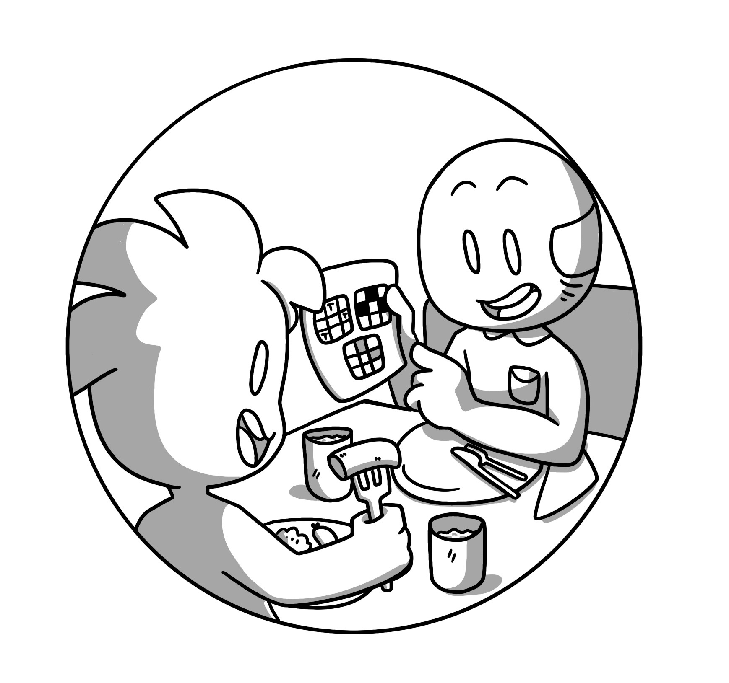

Mathematical Thinking

Slide 2


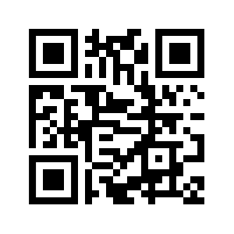



This comic was created as part of the Comixplain research project, funded by the University of Applied Sciences St. Pölten (USTP) through the Innovation Call 2022.
Project Team:
Victor-Adriel De-Jesus-Oliveira
Hsiang-Yun Wu
Christina Stoiber
Magdalena Boucher
Alena Boucher
Contact:
victor.oliveira@ustp.at
Illustrations: Magdalena Boucher & Alena Boucher
Mathematical Thinking © 2025 by Comixplain Team (Victor-Adriel De-Jesus-Oliveira, Hsiang-Yun Wu, Christina Stoiber, Magdalena Boucher, and Alena Boucher) with illustrations by Magdalena Boucher and Alena Boucher, University of Applied Sciences St. Pölten (USTP), licensed under CC BY-SA 4.0
https://www.comixplain.cc

Slide 3
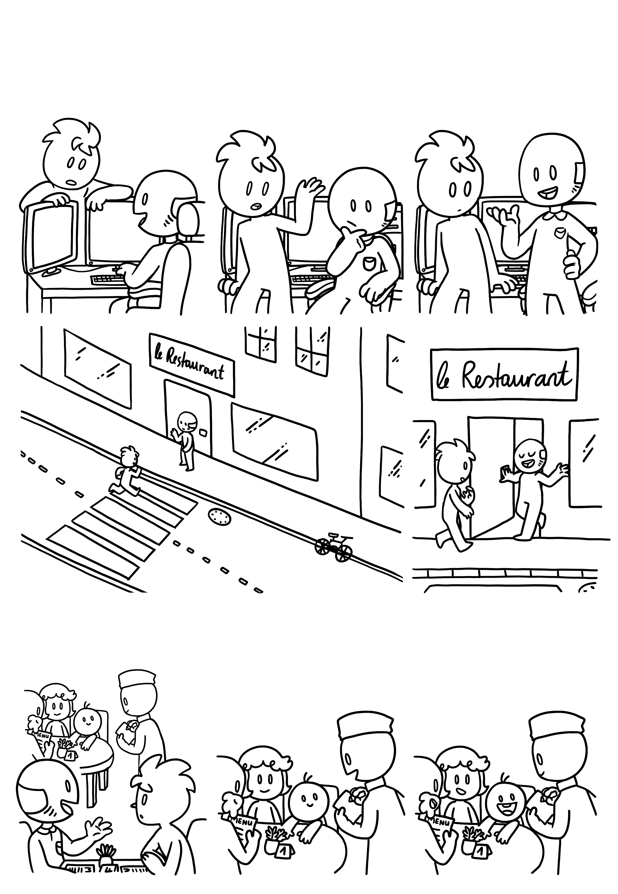
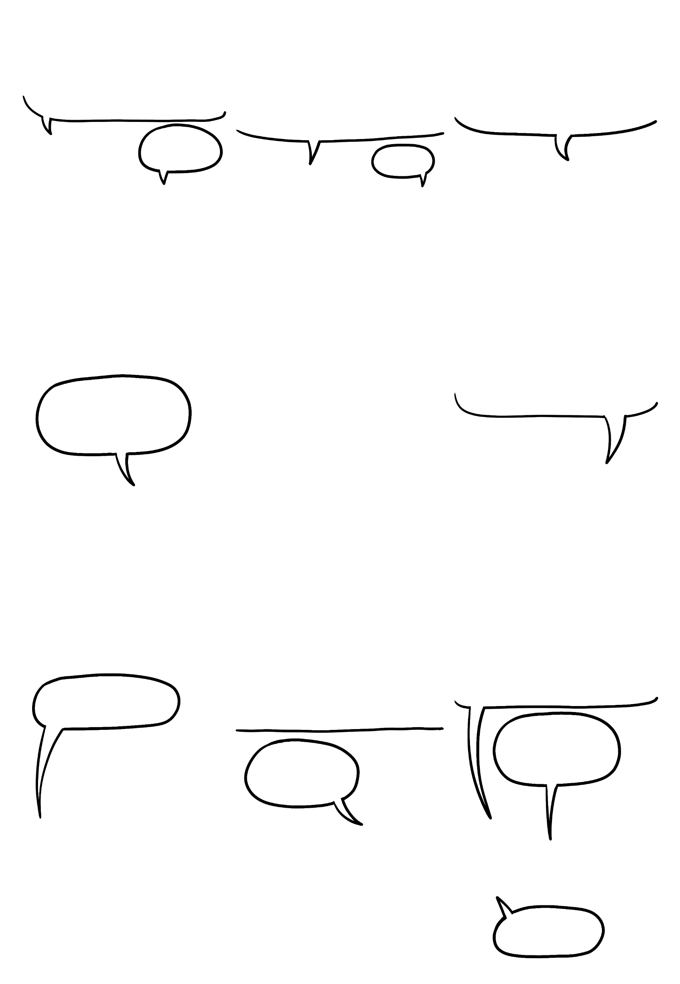
One Viennese Schnitzel, please.
Mathematical Thinking
Hey Gramps, can I ask you something?
So… For homework, I have to describe a scenario with a mathematical way of thinking. But I don‘t know how to proceed step by step.
You know what? Let‘s talk about this over lunch at the restaurant down the road!
Sure.
Hmm…
Well, you needed a scenario - I think this is a good example.
Why are we going to a restaurant to talk about my homework?
Look at the waiter.
He runs around and takes orders from customers.
I‘ll order a salad, please.
I‘d like to try the fish special!
What can I get for you?

Slide 4
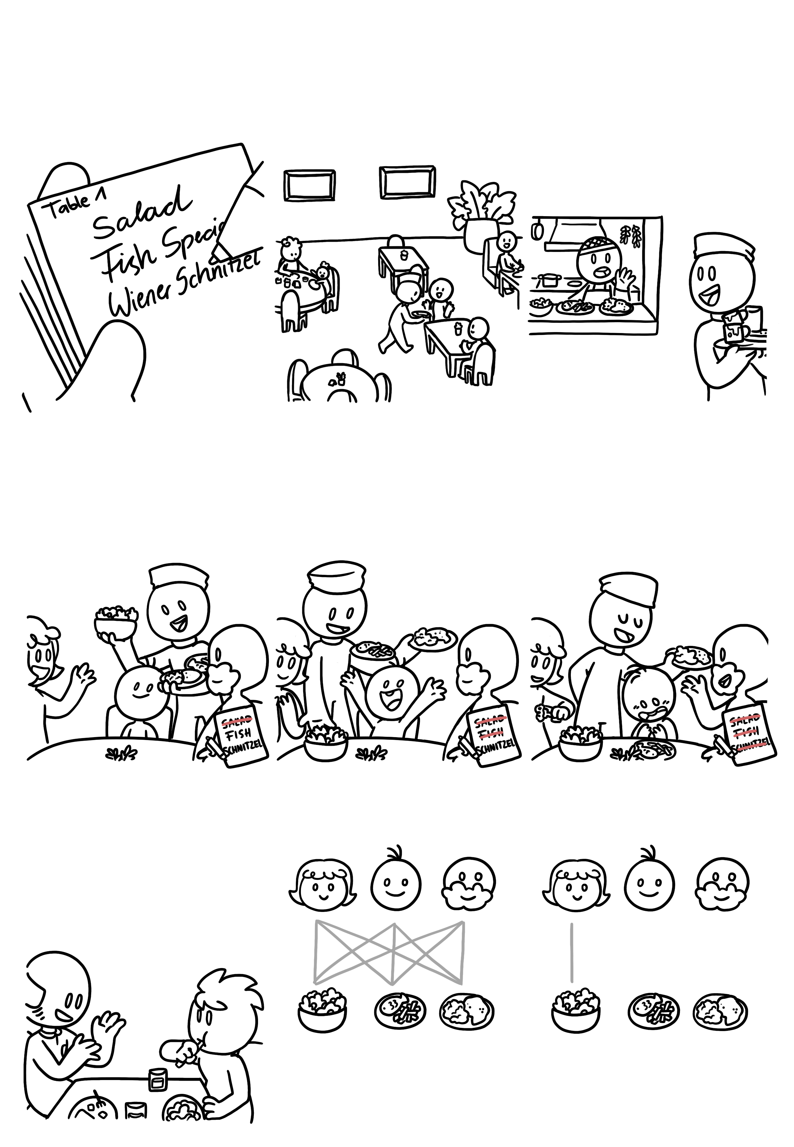
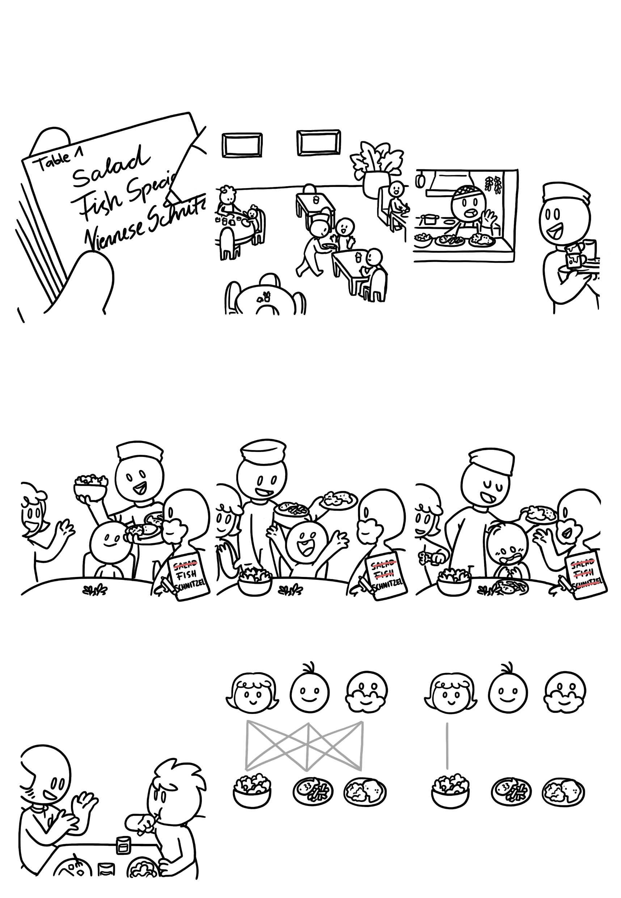
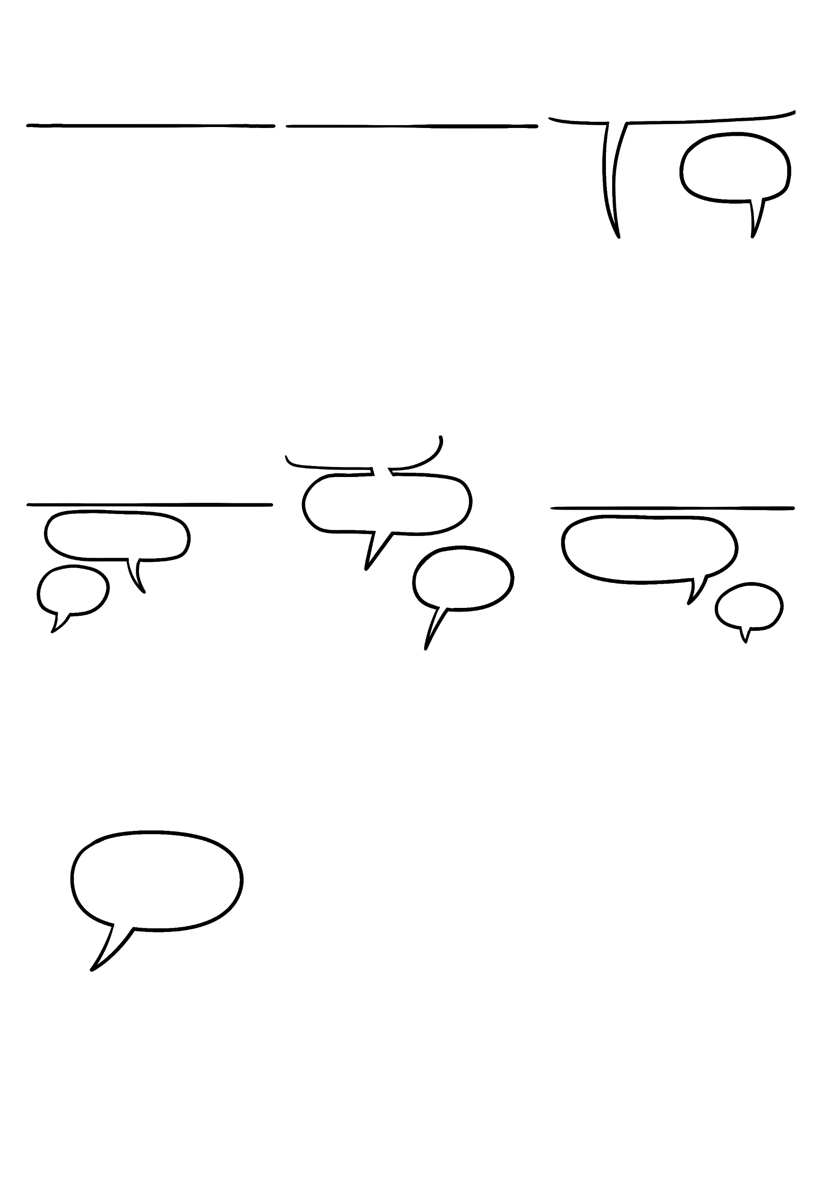


How many possibilities are left?
Mathematical Thinking
The waiter writes down the table‘s order…
…and continues his work, until…
Food for table one is ready!
Coming!
Now the waiter must give each customer the correct meal. Usually, he will ask who gets what.
For you, ma‘am.
For the last meal, he doesn‘t have to ask, because there is only one food and one customer left.
Who gets the fish?
Who gets the salad?
And the Viennese Schnitzel for you, sir.
I do!
That‘s for me!
Thanks!
Now, we could take this scenario of getting the right meal to the right customer and try to find a mathematical approach to this „problem“.
We have three customers and three meals.
What happens as soon as one match is found?
This means that there are nine possible combinations.

Slide 5
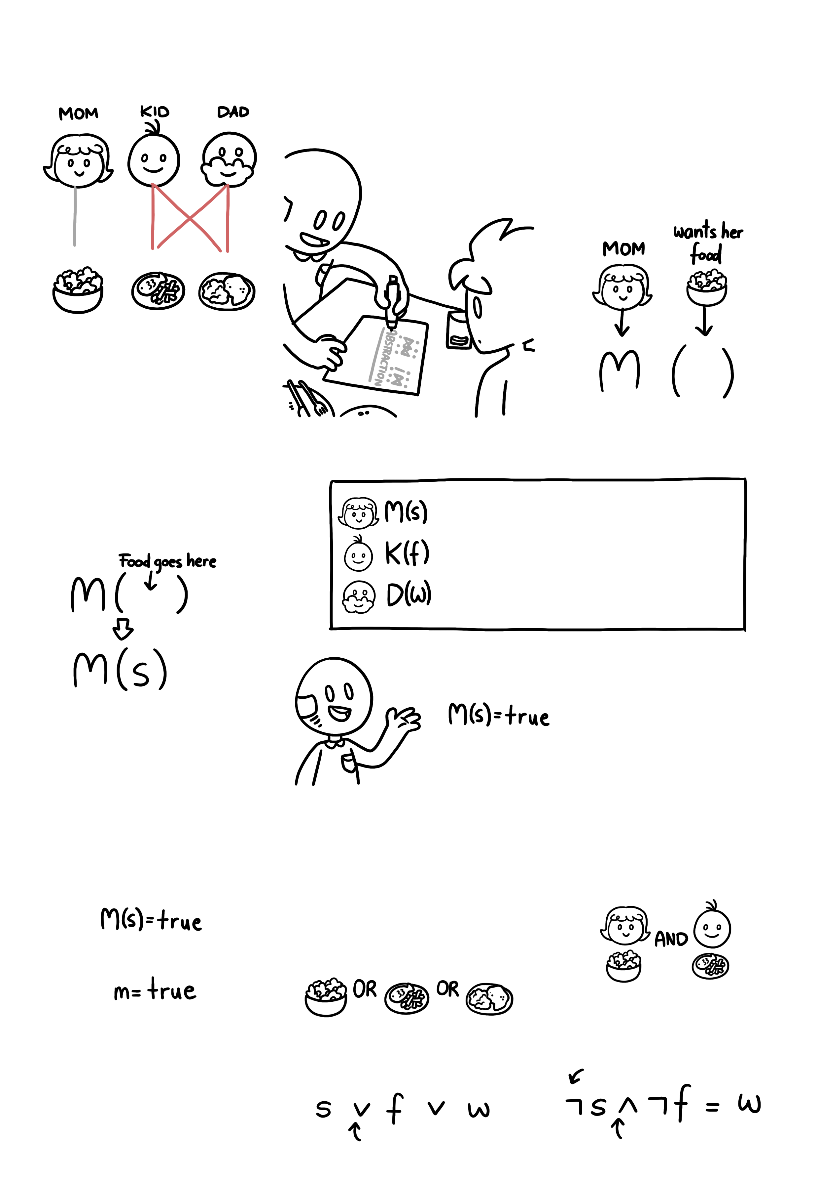

In a mathematical notation, this would look like this:
Mathematical Thinking
We can also describe this meal-to-customer-problem with mathematical notation. This transformation process is called „abstraction“.
Through the abstraction, the problem is described in a way that it can easily – mathematically – be applied to other cases. For example, the mom, who gets the salad, can be abstracted in the following way:
So, as soon as one combination is fixed, the problem becomes easier - there are only four possibilities left.
The food for the mom has to be put into the brackets. She gets the salad, so we’ll abbreviate that with “s”.
The same can be done with the other customer-meal-relationships as well:
means “The salad is given to the mom”.
means “The fish is given to the kid”.
means “The Schnitzel is given to the dad”.
If the salad is the correct food for the mom, then we can say:
M(s) is our mathematical notation for the sentence “The salad is given to the mom”.
This describes a fact.
Mathematicians want to write as little letters as possible, so technically, instead of
We can describe everything the waiter knows at first in a mathematical way.
After having delivered two correct meals, he knows that the dad can’t get the salad or the fish, since the following is already on the table:
If each customer can get one meal, the mom can get either:
we could also write
salad
fish
schnitzel
This means that the dad does NOT get the salad AND NOT the fish, which leaves only the schnitzel:
Or x=true. Or a=true. Anything, really; you could even use an emoji. It’s just a variable that represents a value.
this is the “math symbol” for NOT
this is the “math symbol” for OR
and this stands for AND

Slide 6
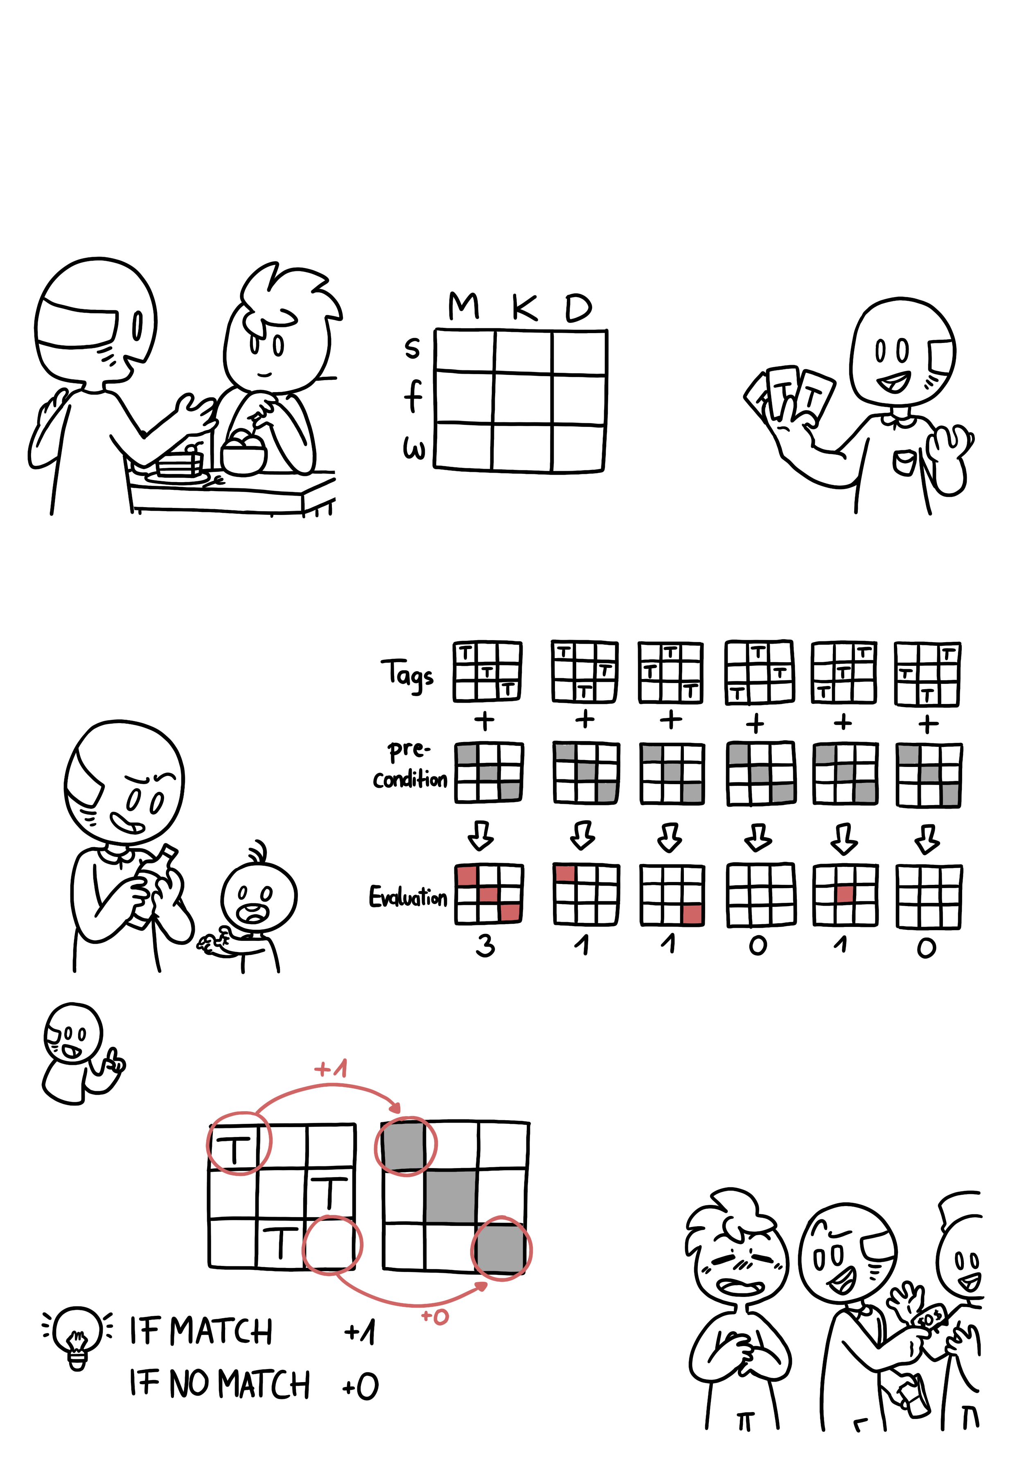
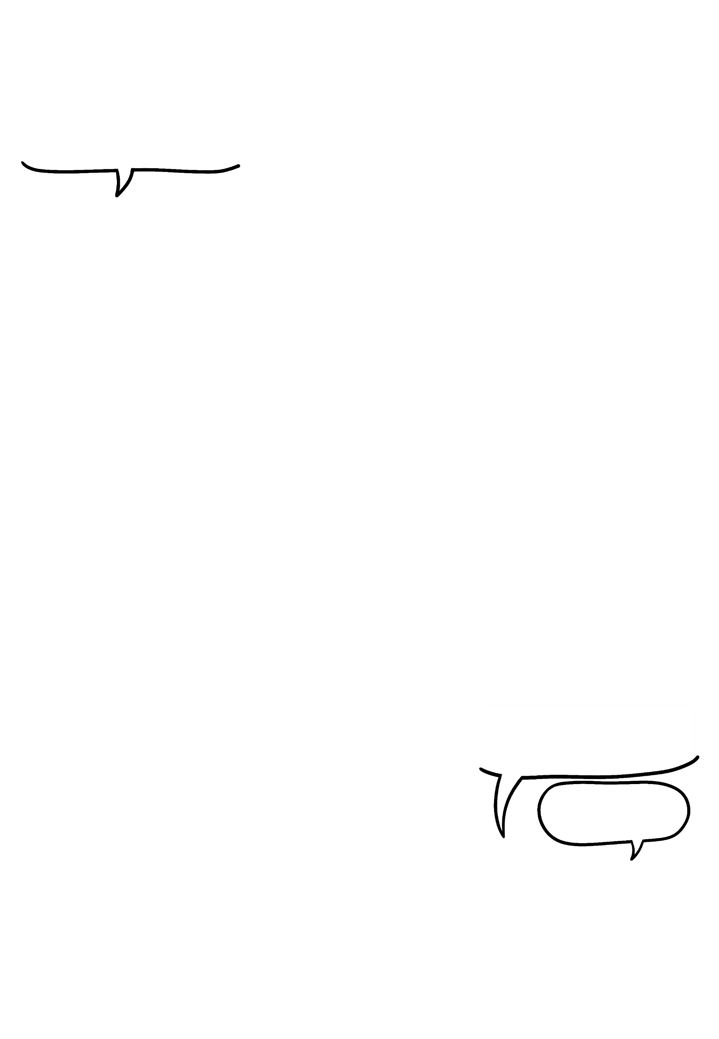
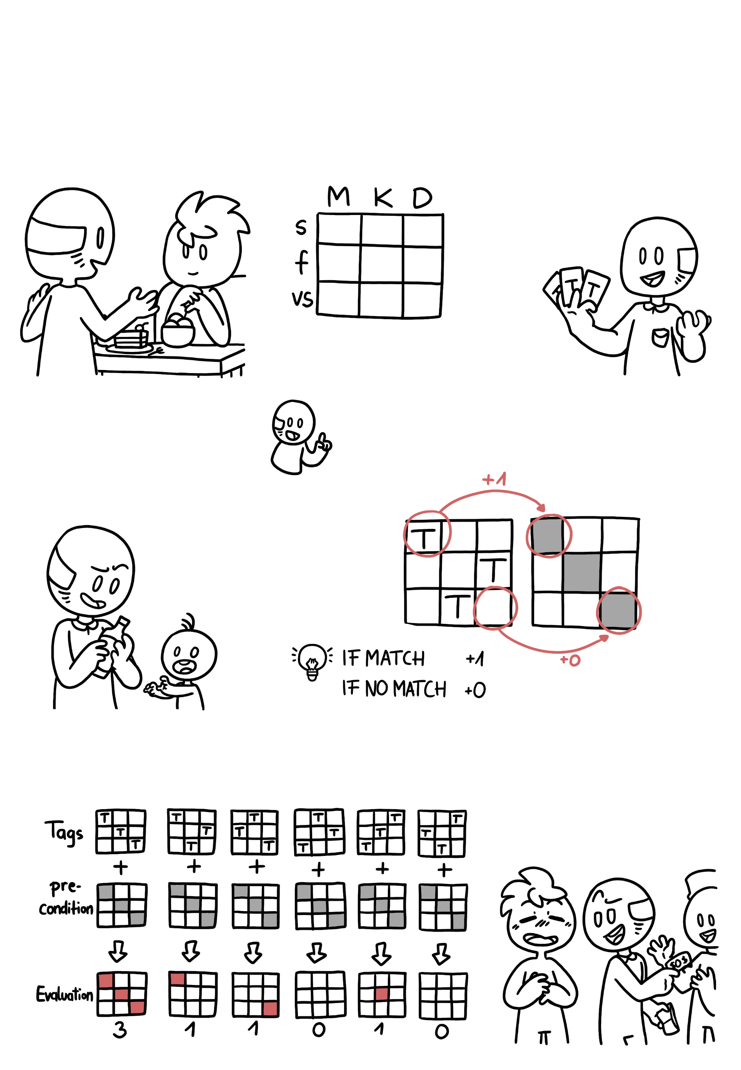


(homework) = true ?
Mathematical Thinking
As the waiter, I could evaluate my performance mathematically, too. Basically, I want to check how many people got their food delivered correctly.
We can do this with a "matching game" of sorts. This table shows all possible combinations of customer and food:
…and we have three tags to put in a cell. But a can only appear in one row or column, since every customer can only get one of the three meals.
In different cases, there might even be some restrictions - so-called constraints. For example, a kid can’t get any alcohol. In that case, one of the cells would be “blocked”.
For each meal and customer, we look whether the placement of our matches the precondition. If it does, we get one point, if it doesn't, we don't. And if we get all 3 points, we win!
There could be many solutions to our “problem”, but only one is correct. The correct solution would be the precondition, and we have to evaluate how our guess fits this precondition.
Oof, I’m full now… but hey, I finished my homework!
So that means

Slide 7

How to cite this document: Wu, H.-Y., Boucher, A., Boucher, M., Stoiber, C., & De-Jesus-Oliveira, V.-A. (2025). Mathematical Thinking. University of Applied Sciences St. Pölten (USTP). https://www.comixplain.cc This comic book was adapted from: Mathematical Thinking © 2023 by Comixplain Team: Victor-Adriel De-Jesus-Oliveira, Hsiang-Yun Wu, Christina Stoiber, Magdalena Boucher, and Alena Ertl, with illustrations by Magdalena Boucher and Alena Ertl, all employed by Sankt Pölten University of Applied Sciences is licensed under CC BY-SA 4.0. To view a copy of this license, visit http://creativecommons.org/licenses/by-sa/4.0/
Sources:
Ben-Ari, M. (2012). Mathematical logic for computer science. Springer Science & Business Media.
Devlin, K. J. (2012). Introduction to mathematical thinking (Vol. 331). Palo Alto, CA: Keith Devlin.

